Slide 1
REST

Slide 2
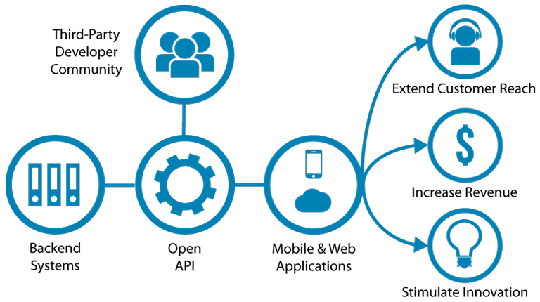
Systems depending on other systems
APIs lets applications interface to backend systems.
If the API is public, it can be used from other systems if you give the system access.

Slide 3
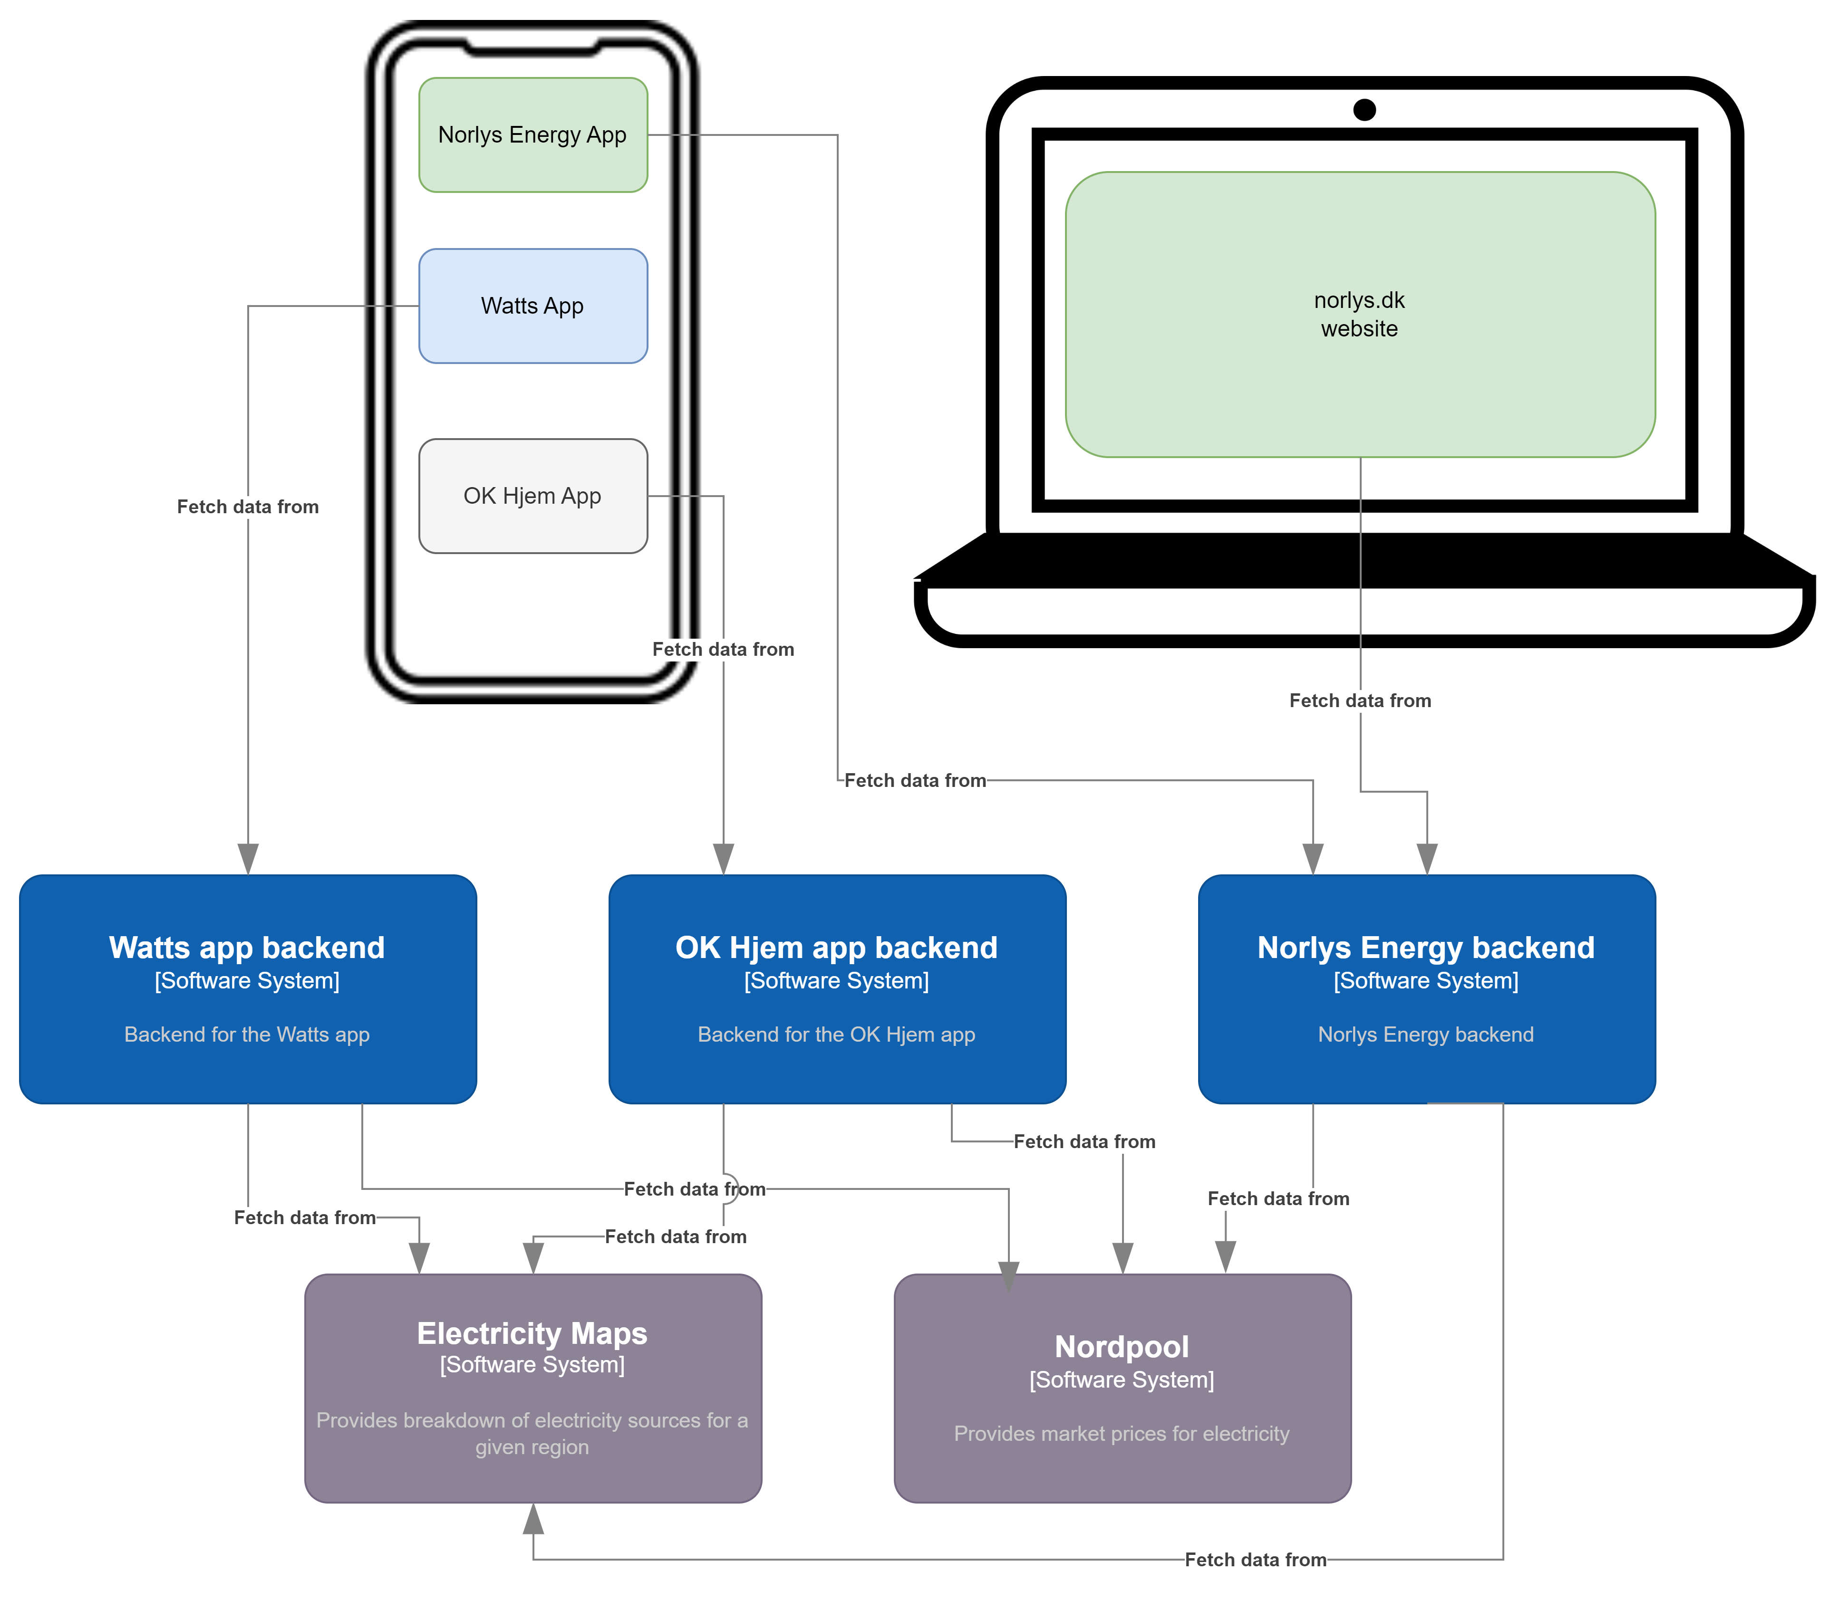
Example
Notes:
Nordpool is a service, which provides electricity prices. Electricity Maps is a service, which provides a breakdown of electricity sources (wind, solar, coal, nuclear, etc.).
The companies ‘Watts’, ‘OK’ and ‘Norlys’ each has an app, that show this information. They subscribe to the Nordpool and Electricity Map services and their backends integrate to the same REST API.
The Norlys backend provides data to both their app and the norlys.dk website.

Slide 4
WHAT IS REST?
A set of guiding principles that a Web API should adhere to, to be a REST API
Architectural style

Slide 5
REpresentational State Transfer
The ‘State’ is the data managed by the API.
Data is (almost) always stored in a database.
The REST API itself is stateless, it merely translates the data (state) stored in the database to and from JSON objects.

Slide 6
RESTFul principles
Uniform interface
Resource identification
Initial URL
Client-server
Separation of concern
Stateless
The server doesn’t hold any state
Cacheable
The client can save the response
Layered System
Only depended on the next immediate layer
Code on Demand (optional and not often used in practice)
Possibility to extend clients

Slide 7
DESIGNING REST API
Identify resources
Create URI
Determining representation
Assigning HTTP Verbs

Slide 8
Domain model
Before defining a service and the REST API, you should define the domain model.
The domain model describes the domain and the REST API defines how to navigate and query that model.

Slide 9
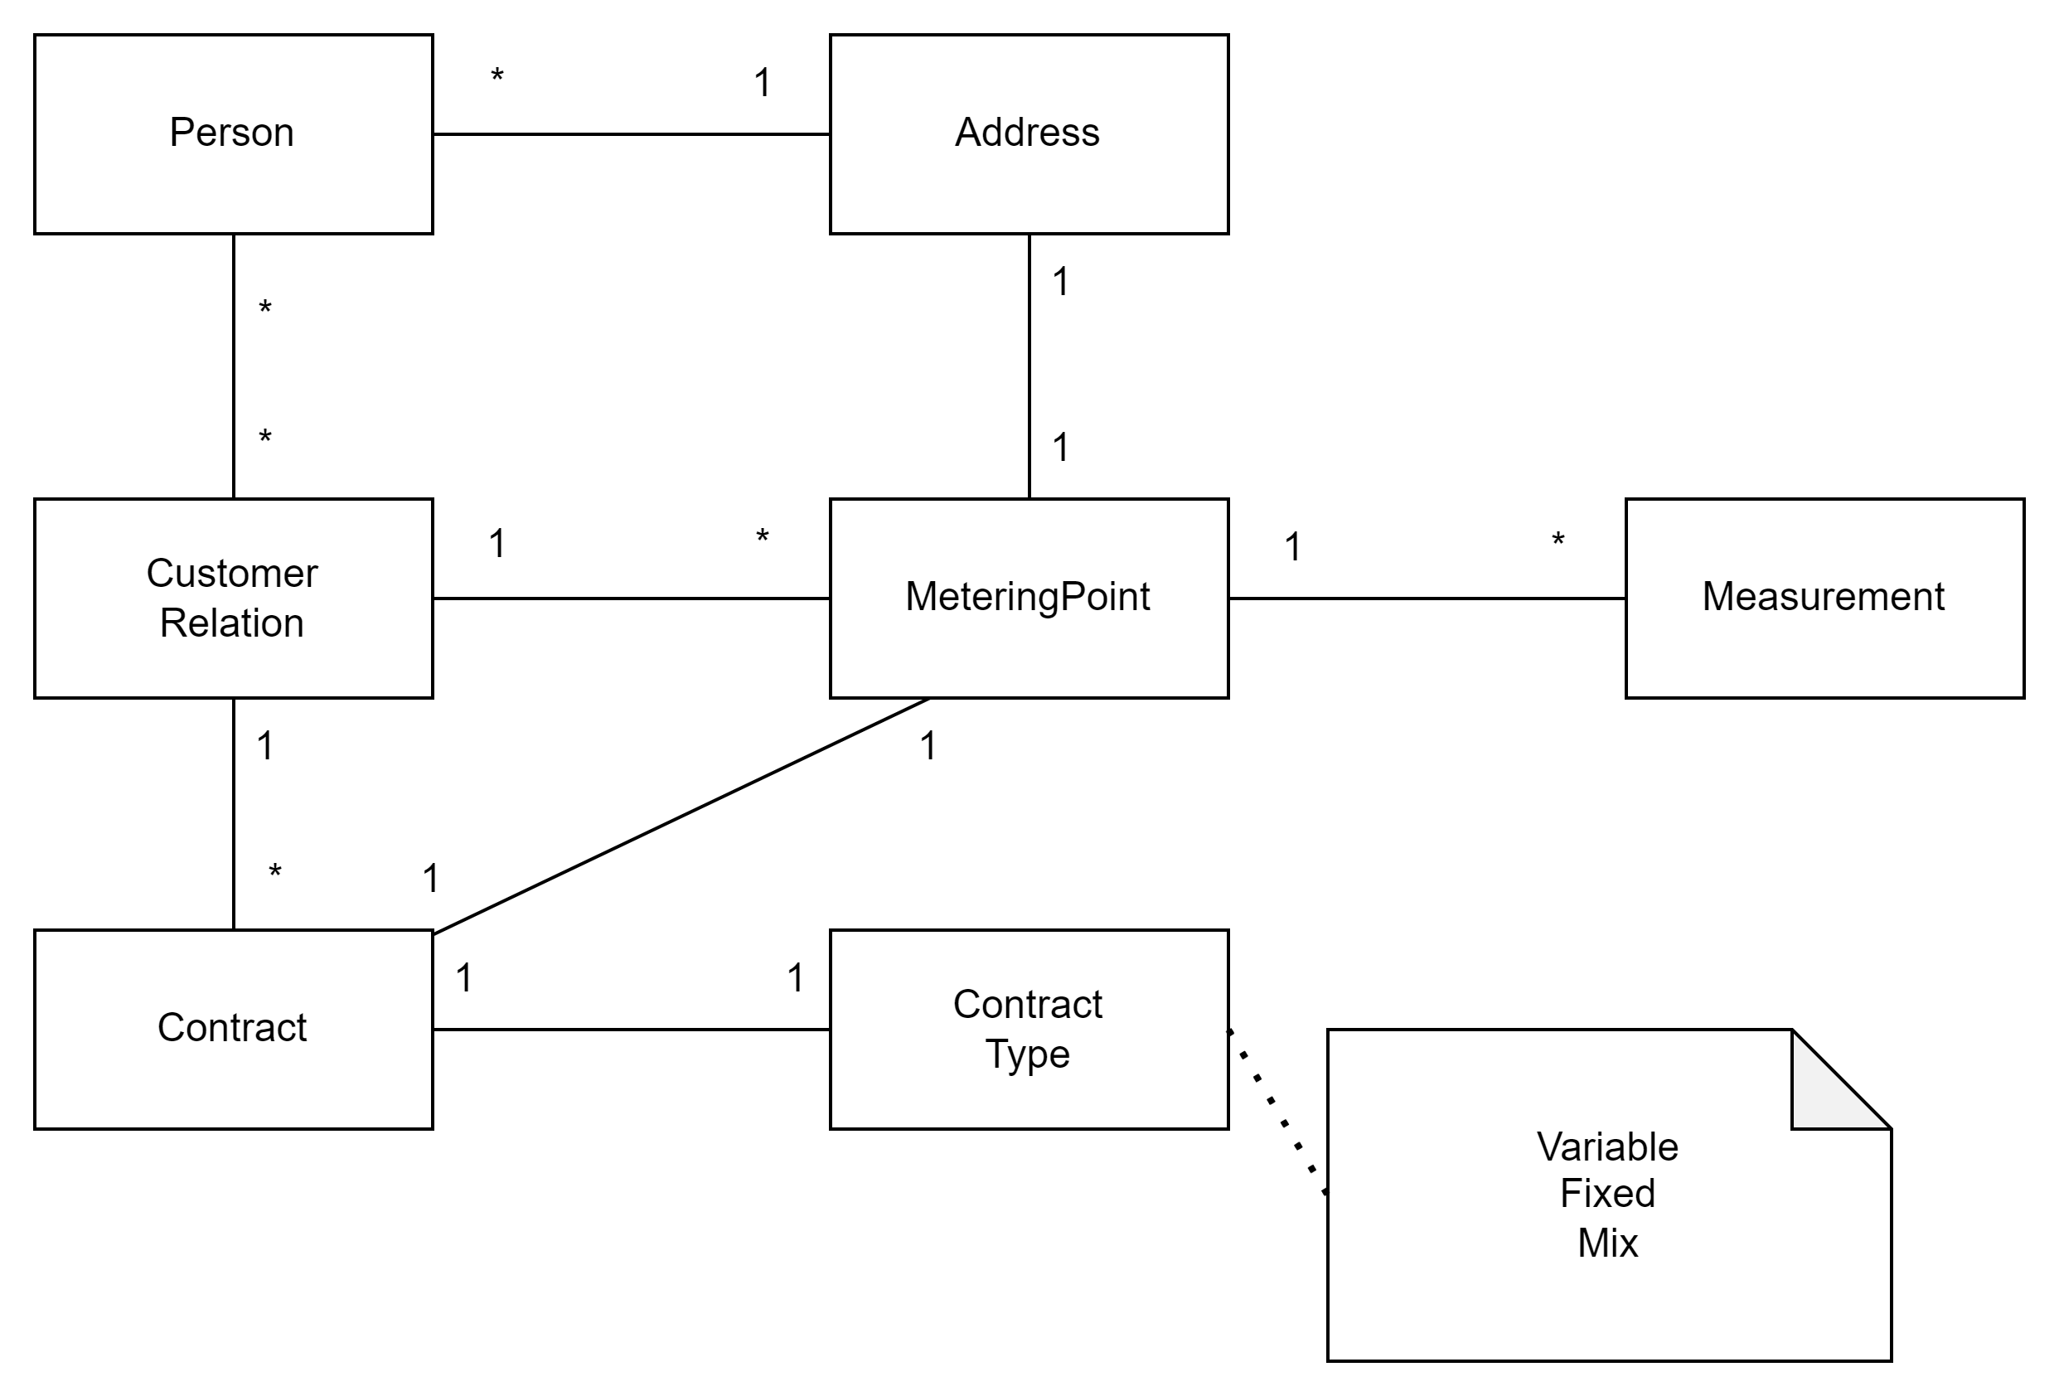
Domain model example
Before defining a service and the REST API, you should define the domain model.
The domain model describes the domain and the REST API defines how to navigate and query that model.
Notes:
Do this on whiteboard.

Slide 10
CREATING URIS
Should be nouns only
Resource normally in plural
And {id} to select specific
/patients vs /patients/{cpr}
Sub-collections can be specified in URL by specifying collection URL
/patients/{id}/observations

Slide 11
CREATING URIS
Should be nouns only
Resource normally in plural
And {id} to select specific
/patients vs /patients/{cpr}
Sub-collections can be specified in URL by specifying collection URL
/patients/{id}/observations
Think carefully about, how API clients should be able to navigate your data model as structured trees. The API reflects that.

Slide 12
CREATING URIS
Should be nouns only
Resource normally in plural
And {id} to select specific
/patients vs /patients/{cpr}
Sub-collections can be specified in URL by specifying collection URL
/patients/{id}/observations
Think carefully about, how API clients should be able to navigate your data model as structured trees. The API reflects that.
You probably need to redesign your API 2 - 3 times before you are satisfied. Don’t worry – this is normal.

Slide 13
RESOURCE REPRESENTATION
Either XML or JSON
Returning the most important data - especially when returning a collection
Returning a single resource
Include all data
Include relevant links
E.g. link to patients observations
/patients/1234567890/oberservations/123
/patients/1234567890/oberservations/180
/patients/1234567890/oberservations/231

Slide 14
HTTP VERBS
Very similar to basic database operations:
Create - POST
Read - GET
Update - PUT
Delete - DELETE
Use GET to browse data
Big collections should have pagination
/patients/123456789/observations
Use POST to create
Use PUT to update
Use DELETE to delete

Slide 15
HATEOAS
Hypermedia As The Engine Of Application State
{
"departmentId": 10, "departmentName": "Administration", "locationId": 1700, "managerId": 200,
"links": [ {
"href": "10/employees", "rel": "employees",
"type" : "GET”
} ]
}
A dynamic way of navigating to related resources
Clients don’t need to be hard-coded
Don’t need to be in the body – could also be in the header

Slide 16
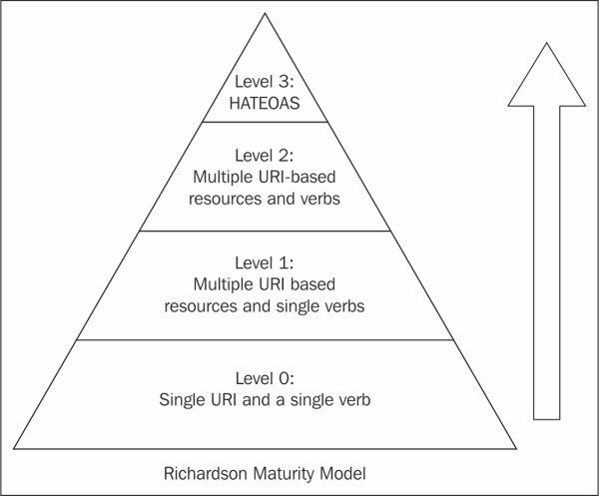
REST MATURITY LEVELS
Level 0:
Single word and single VERB
E.g. only a single http endpoint using post or get
Level 1:
Level 0, but with multiple resources
Level 2:
Multiple resources (endpoints) and uses different VERBs for CRUD operations
This you get from WebAPI if you use it like in the tutorial (1)
Level 3:
Level 2 + HATEOAS
1) WebAPI tutorial: https://learn.microsoft.com/en-us/aspnet/core/tutorials/first-web-api

Slide 17
SECURITY
HTTPS
Always use HTTPs when creating Web API (And web pages in general)
API keys
Hide this key
OAUTH

Slide 18
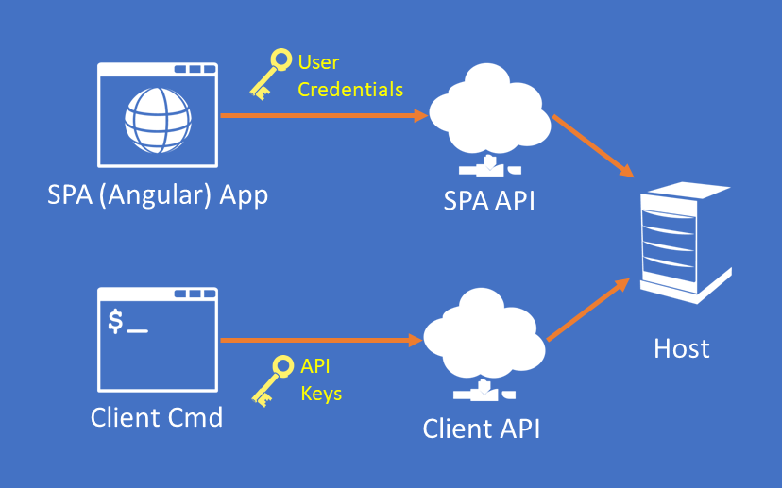
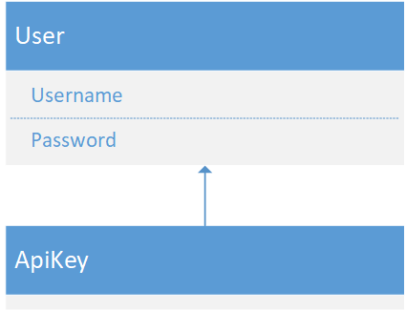
API Keys
A way to connect to an API with credentials that are separate and more limited than login credentials (e.g. username+password)
https://blog.infernored.com/securing-web-apis-with-api-keys/
Notes:
The idea of API Keys is fairly standard with systems that offer an external API. They offer customers a way to connect to an API with credentials that are separate from their own. More importantly API Keys offer limited access, a critical element of a good security model. API Keys can't, for instance, log in to the site and create new API Keys, or manage users. They can only perform the limited actions that the external Web API grants. If the credentials become compromised, users can reject or delete them without affecting their own credentials.
https://blog.infernored.com/securing-web-apis-with-api-keys/

Slide 19
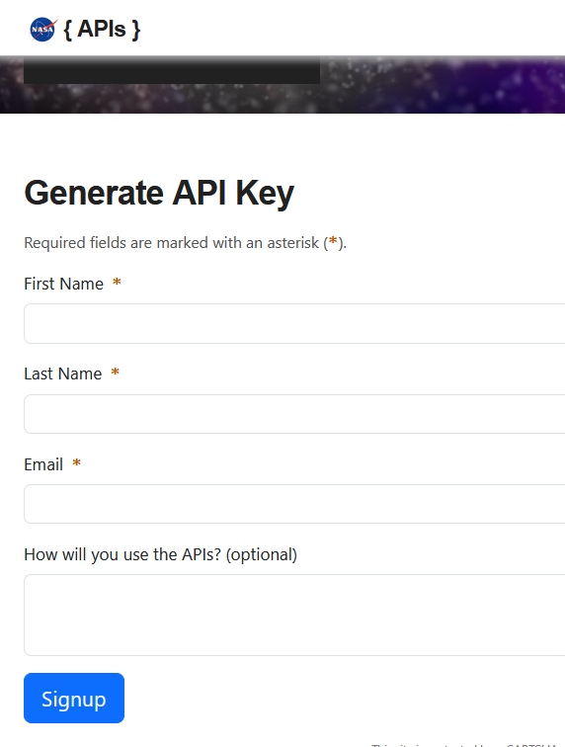
Example of using API keys
Request key on https://api.nasa.gov/

Slide 20
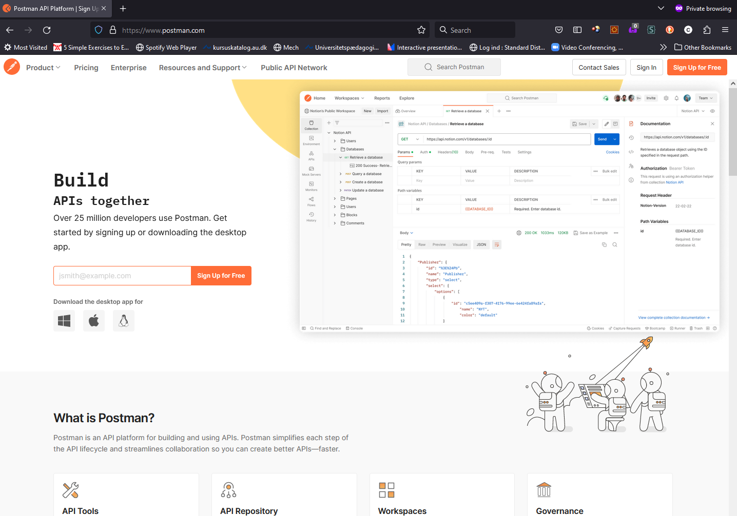
Create a free account
Notes:
We will use Postman, which is very common in the industry.

Slide 21
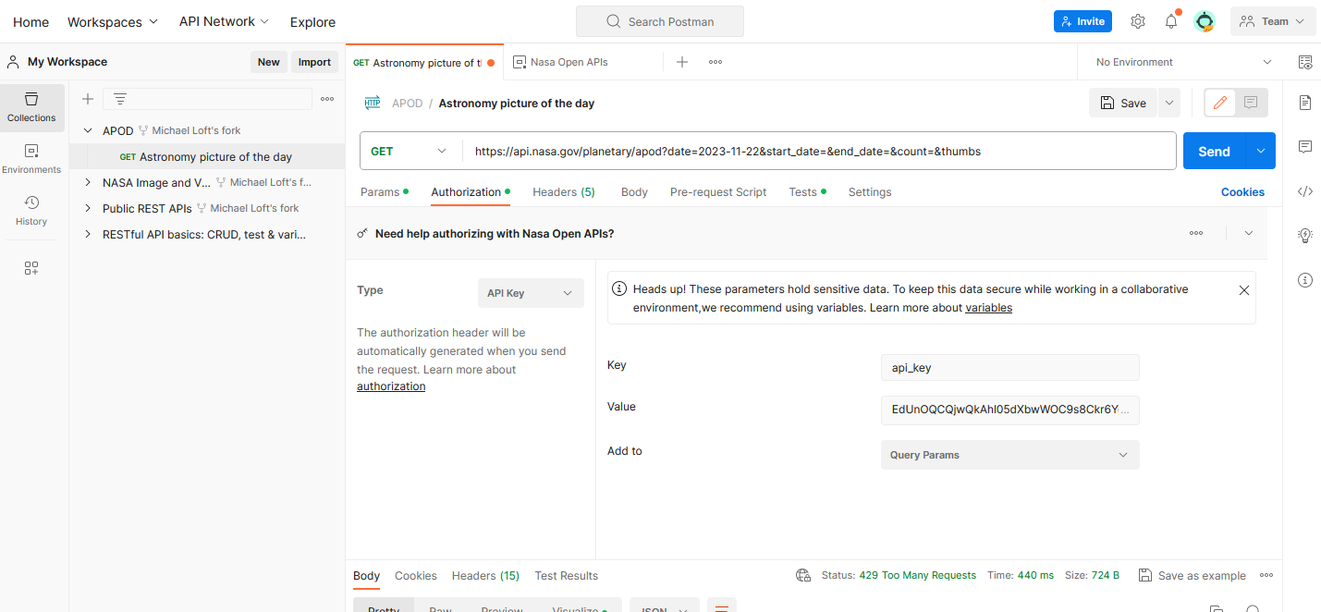
Add key in Postman

Slide 22
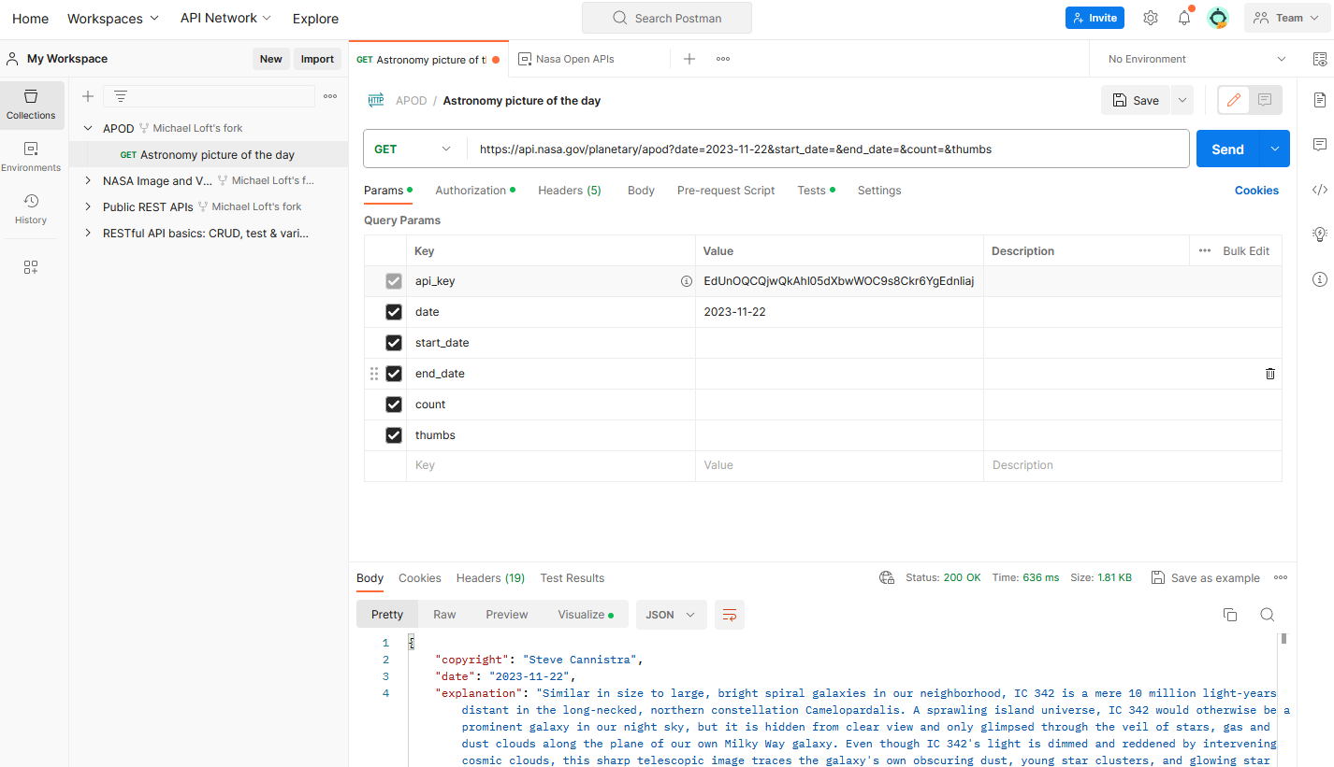
Send request

Slide 23
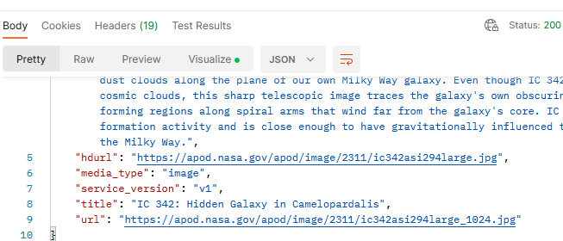
HATEOAS

Slide 24


Slide 25
Get API data with HttpClient
internal class Program
{
private static string apikey = "41bc70d1fe048213997112adbc759840";
private static HttpClient sharedClient = new()
{
BaseAddress = new Uri("http://api.openweathermap.org")
};
static void Main(string[] args)
{
using HttpResponseMessage response =
sharedClient.GetAsync($"/geo/1.0/direct?q=Aarhus&appid={apikey}").Result;
Console.WriteLine(response);
var content = response.Content;
var contentResponse = content.ReadAsStringAsync().Result;
Console.WriteLine($"{contentResponse}\n");
}
}

Slide 26
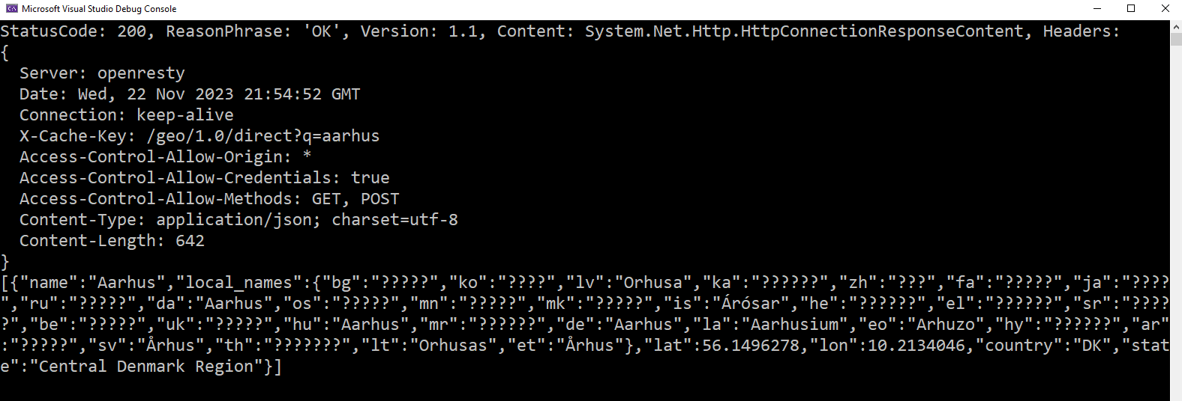
Get API data with HttpClient
internal class Program
{
private static string apikey = "41bc70d1fe048213997112adbc759840";
private static HttpClient sharedClient = new()
{
BaseAddress = new Uri("http://api.openweathermap.org")
};
static void Main(string[] args)
{
using HttpResponseMessage response =
sharedClient.GetAsync($"/geo/1.0/direct?q=Aarhus&appid={apikey}").Result;
Console.WriteLine(response);
var content = response.Content;
var contentResponse = content.ReadAsStringAsync().Result;
Console.WriteLine($"{contentResponse}\n");
}
}

Slide 27

Your turn
Solve the exercises

Slide 28
Missing
The difference between authentication and authorization
Using OAuth 2.0 for authorization
API Implementation: One controller pr. entity

Slide 29
References and image sources
Images:
Computer keyboard: http://stockmedia.cc/computing_technology/slides/DSD_8790.jpg
Bonus: http://wjreviews.com/reviews-cta/bonus.png
Cellphone: https://vectorified.com/download-image#iphone-icon-vector-2.png
Laptop: https://clipartix.com/laptop-clipart-image-19319/

